Slide 1
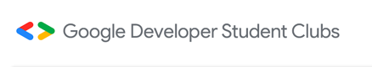
Welcome to Android
Study Jams

Slide 2

What are Android Study Jams?
Android Study Jams are community-organized study groups for people to do hands-on learning for Android app development.
Android Basics is a series of sessions focused specifically on learning how to build Android apps without prior Android experience.

Slide 3
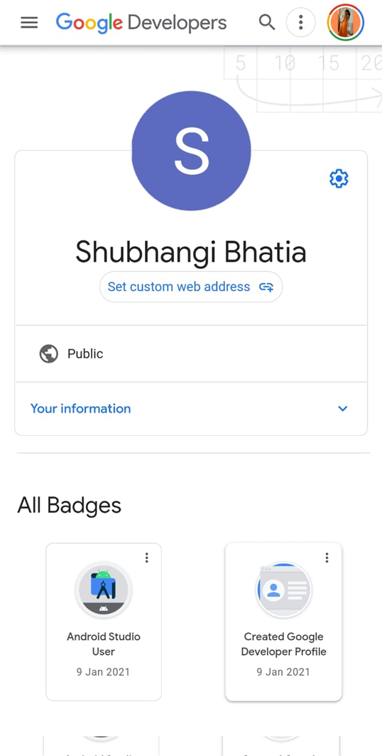
How to start your journey?
To start, you need to create a Developer profile. (https://google.dev/u/new)
Why create Google Developer Profile?
Collect upto 16 badges as you learn
Showcase and share your achievements

Slide 4
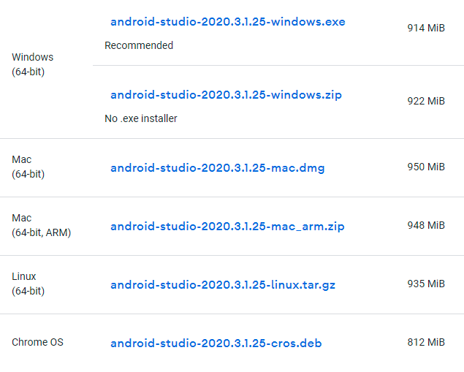
How to proceed?
Next, download and install Android Studio or ItelliJ on your devices.
Download for Windows/Linux/Ubuntu/Mac

Slide 5
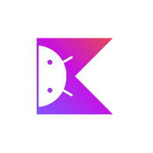
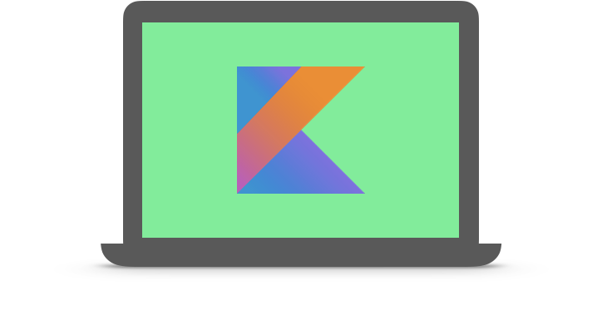
https://developer.android.com/courses/android-basics-kotlin/course Main course link Kotlin Playground https://play.kotlinlang.org

Slide 6
Equipment needed for each student
Computer
Internet connection
(Optional) Android device & USB cable
Android Studio

Slide 7
What will your learning journey look like?
6 Units
16 Pathways
16 Quizzes
16 Badges
Decorated Developer Profile

Slide 8
Android Basics
Learn the basics of building Android apps with the Kotlin programming language and develop a collection of simple apps to start your journey as an Android developer!
Pre-requisites
Basic computer literacy
Basic math skills
Curriculum used
Android Basics in Kotlin Course

Slide 9
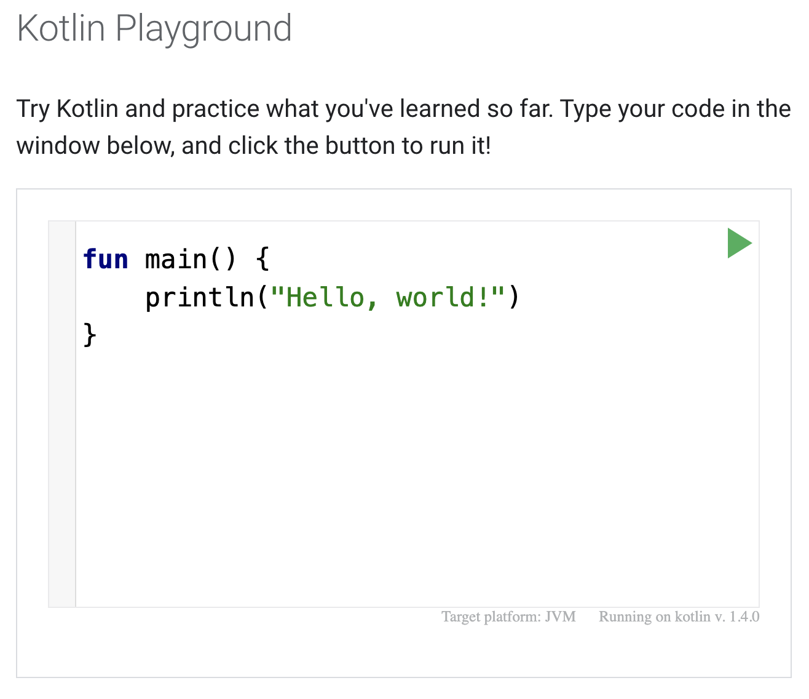

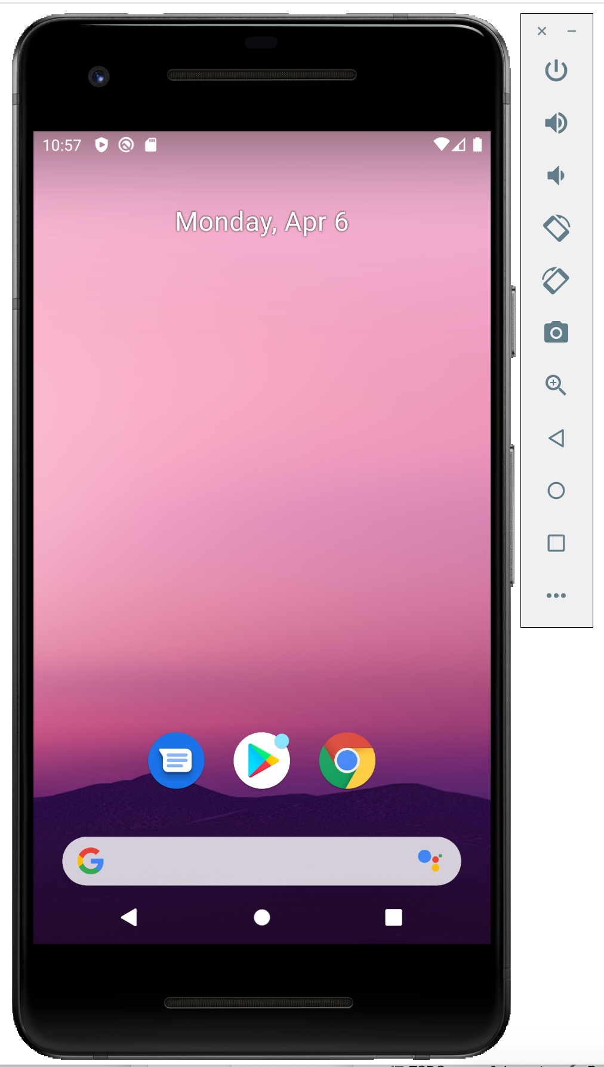

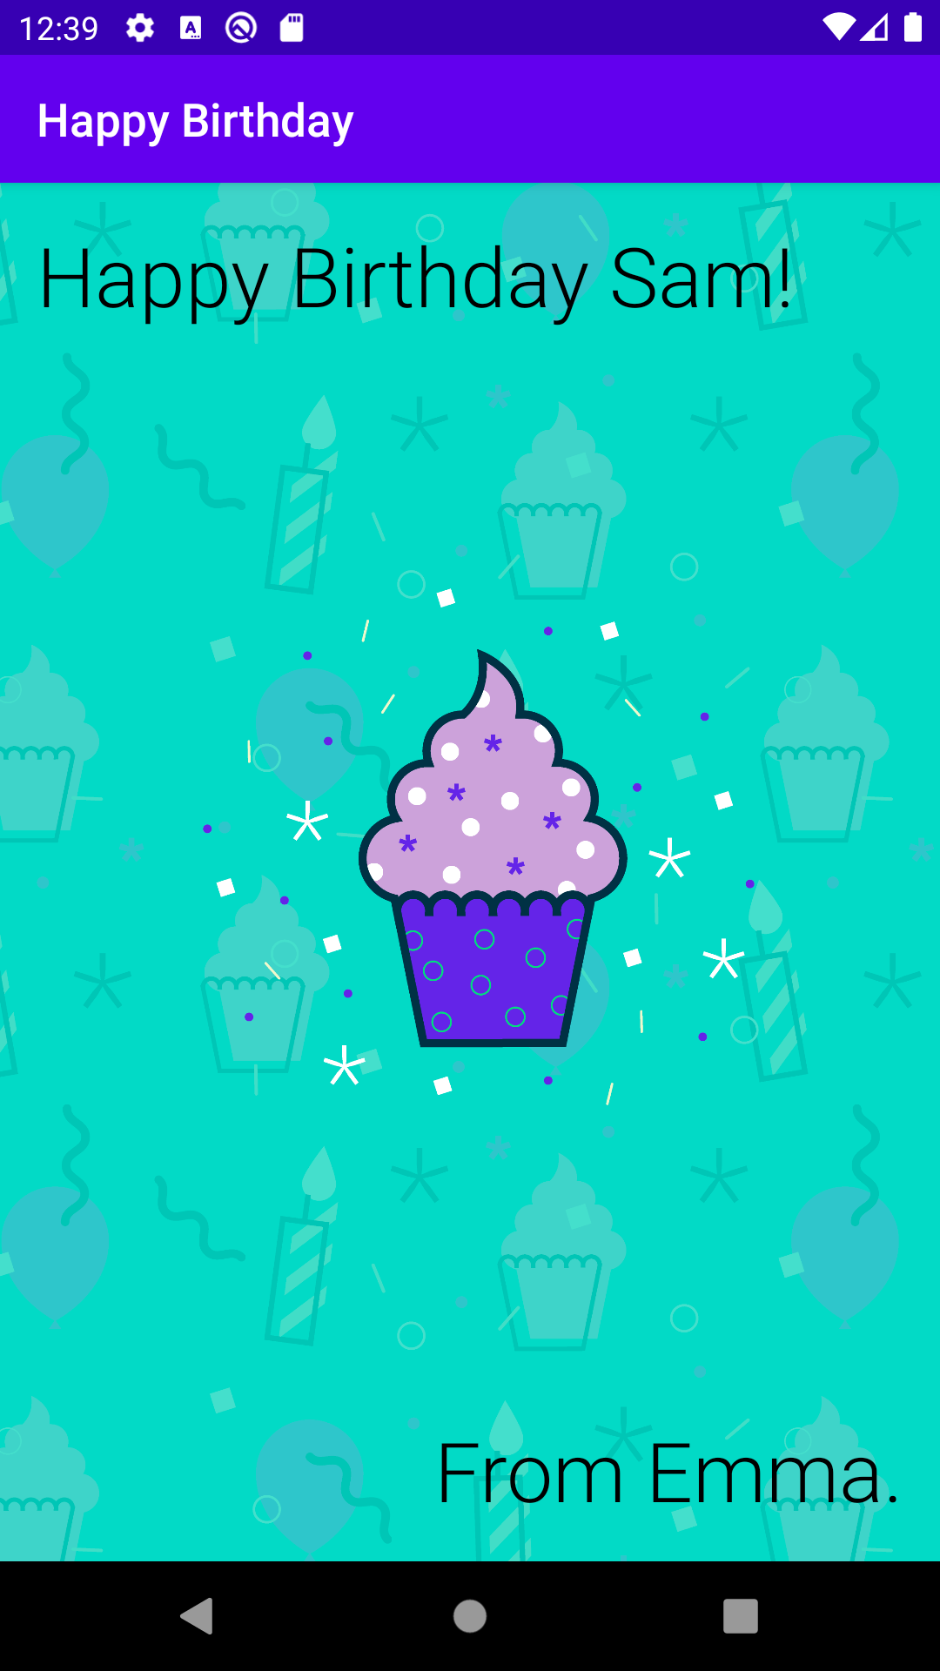

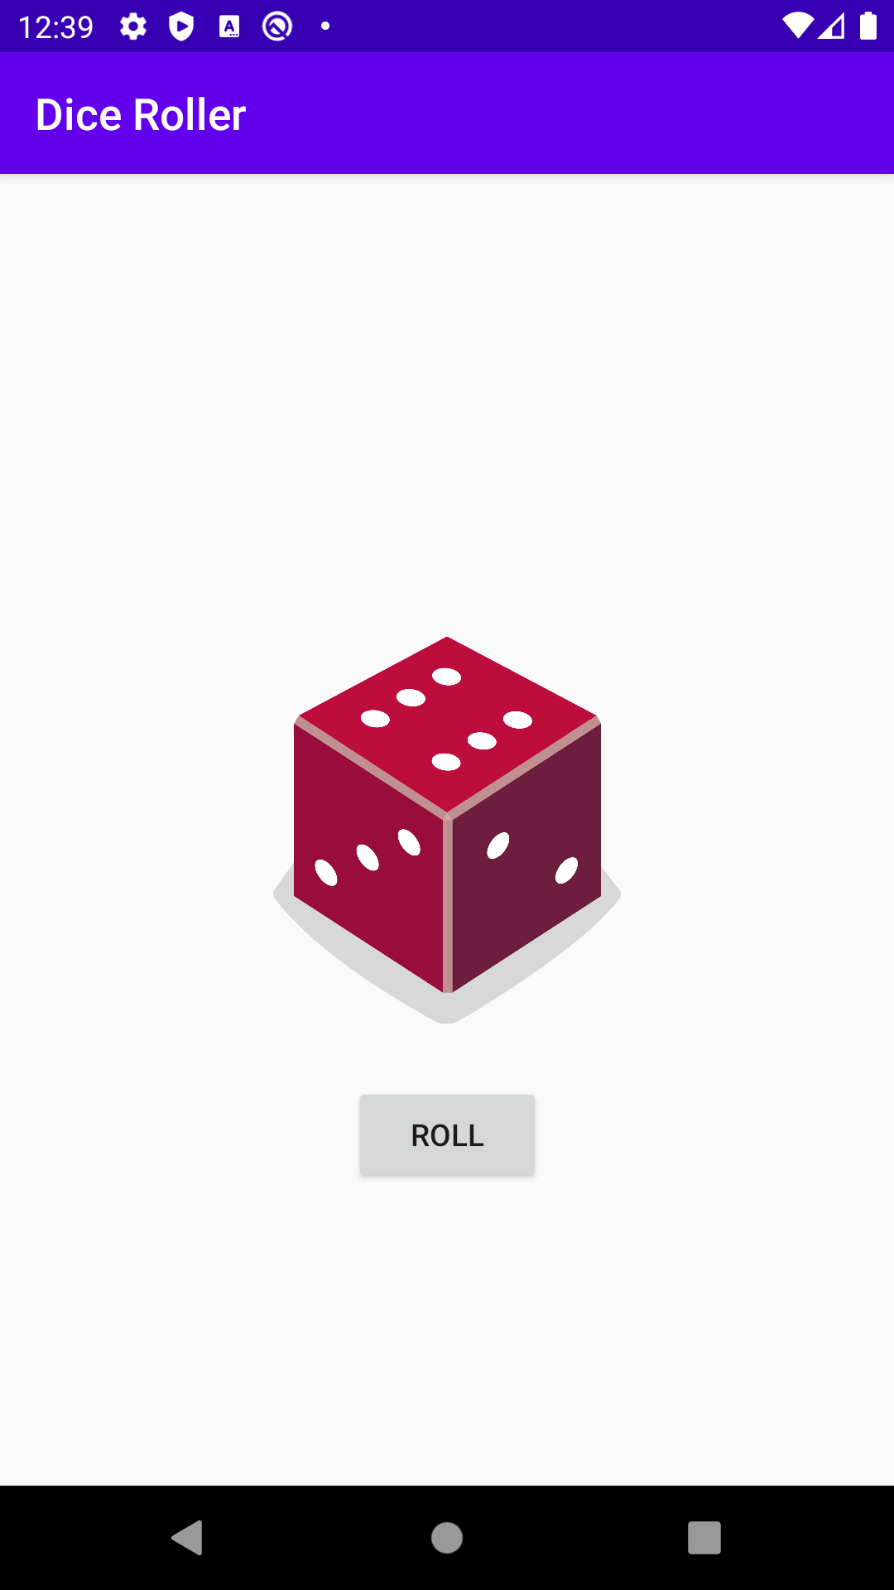

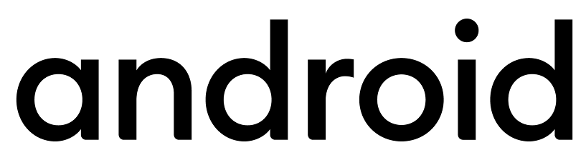
Overview of what you’ll learn
Badges
Earn badges
at the end of each
pathway!
1
Introduction to Kotlin
Learn to code in Kotlin, a modern programming language that helps developers be more productive.
(1 hour)
2
Create your first Android app
Learn to create and run your first Android app in Android Studio.
(2 hours)
3
Build a basic layout
Learn the basics of layouts in Android by creating your very own birthday card app!
(1 hour)
4
Add a button to an app
Learn how to use classes, objects, and conditionals to create an interactive dice roller app.
(3 hours)

Slide 10
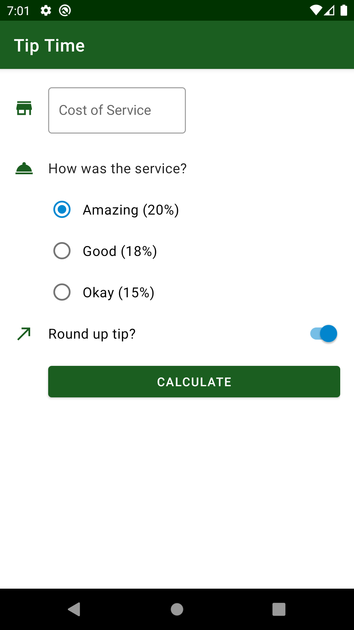

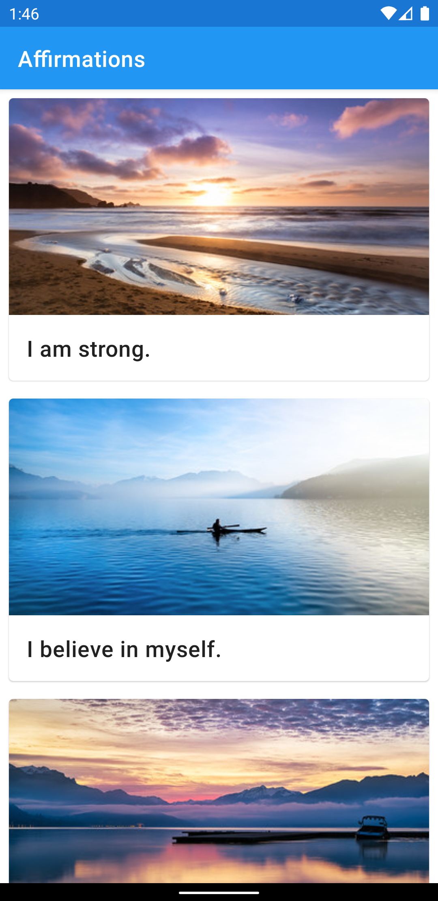

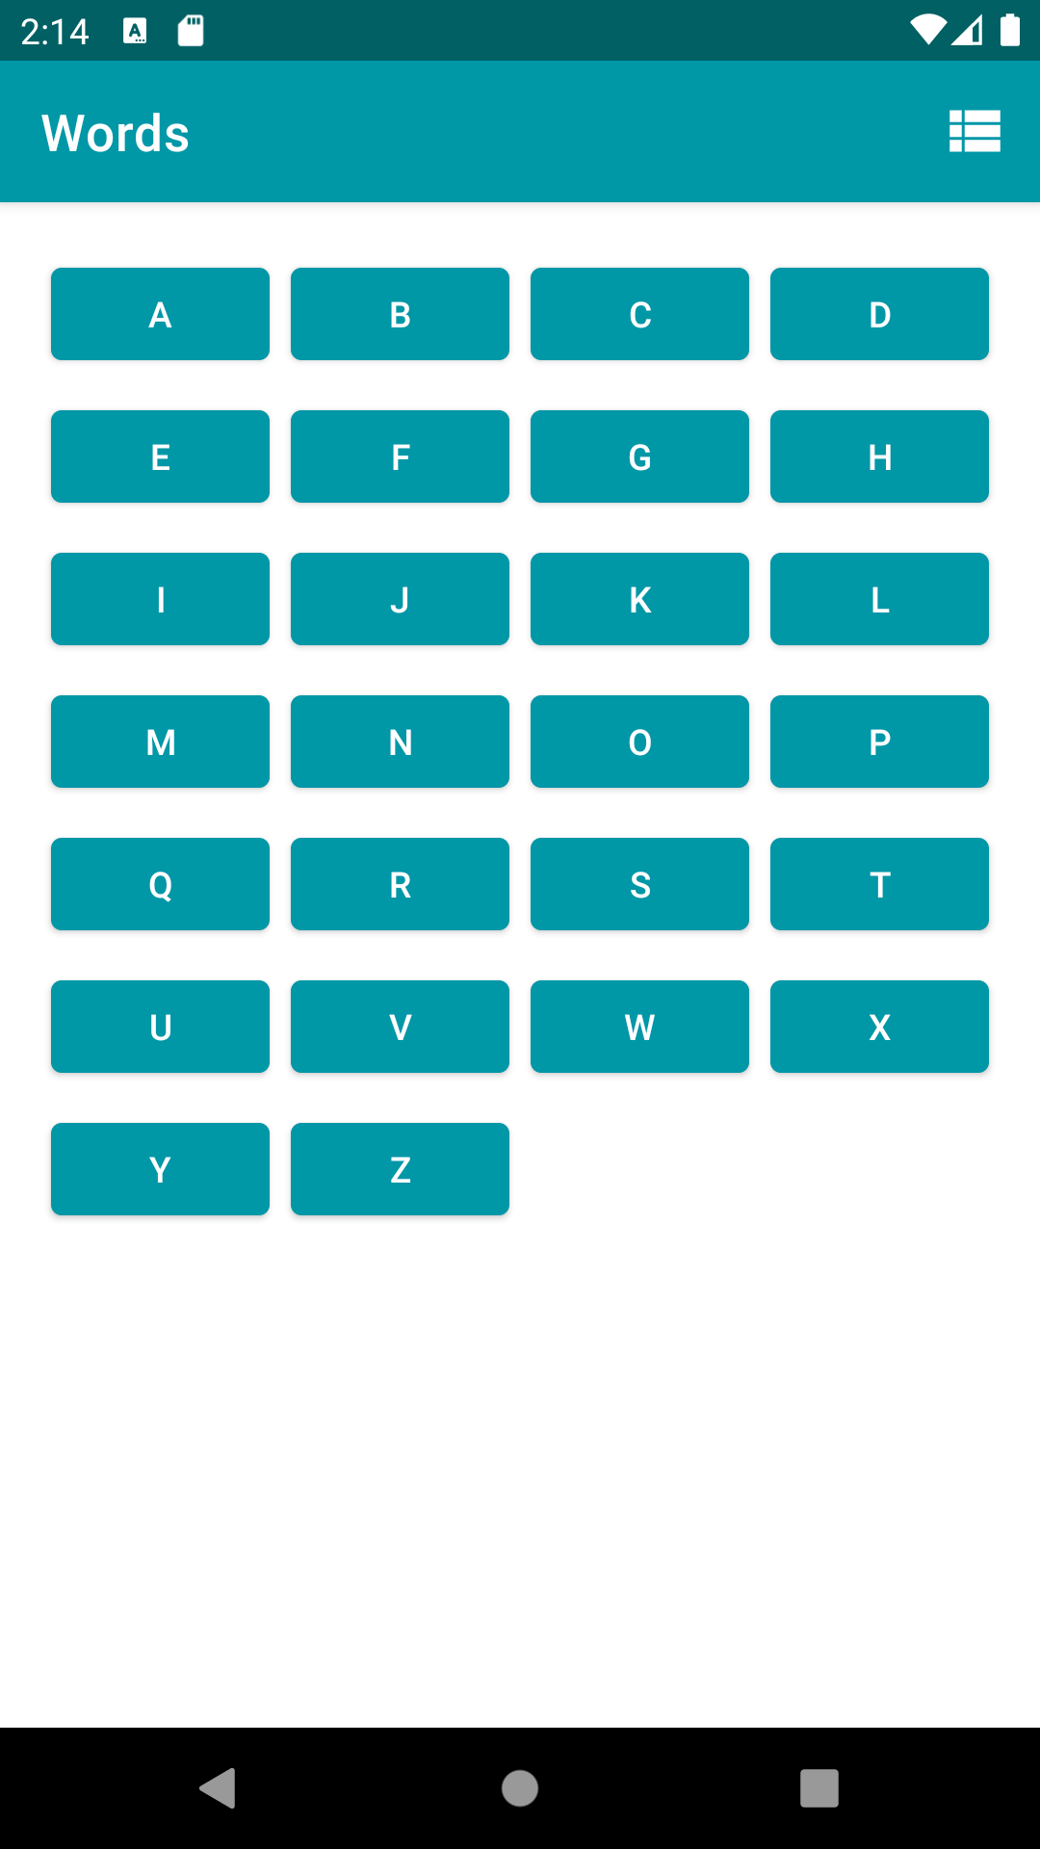

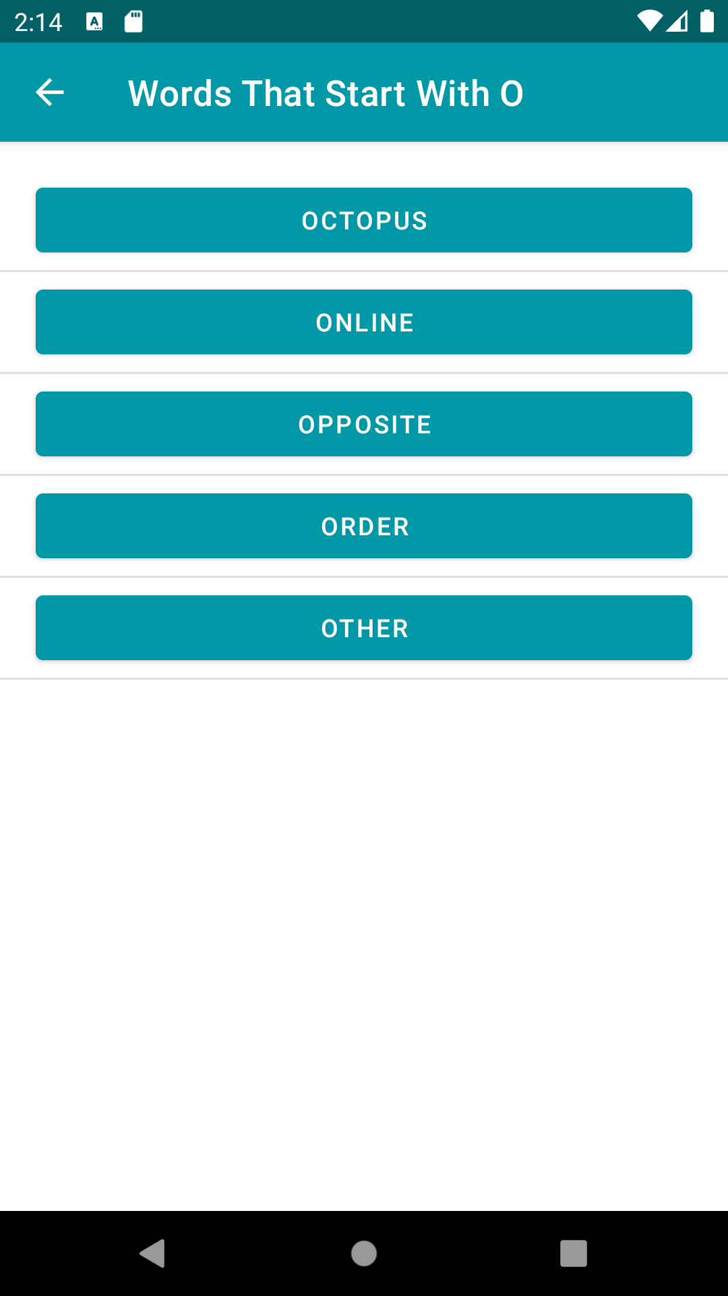
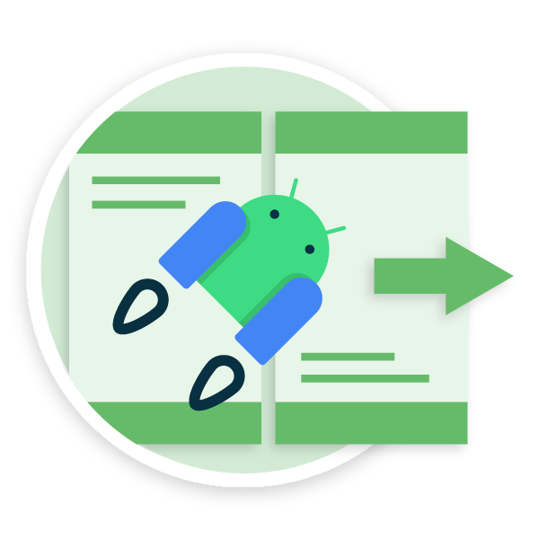
Overview of what you’ll learn
Badges
5
Get user input
Learn how to get user input within an app by building a tip calculator app.
(3 hours)
6
Display a scrollable list
Learn how to display a list of text and images in an app.
(2 hours)
7
Navigate between screens
Add another screen to your app by adding a second activity.
(2 hours)
8
Intro to Navigation Component
Learn how the Jetpack Navigation component makes it easier to manage navigation within your app.
(1 hour)

Slide 11
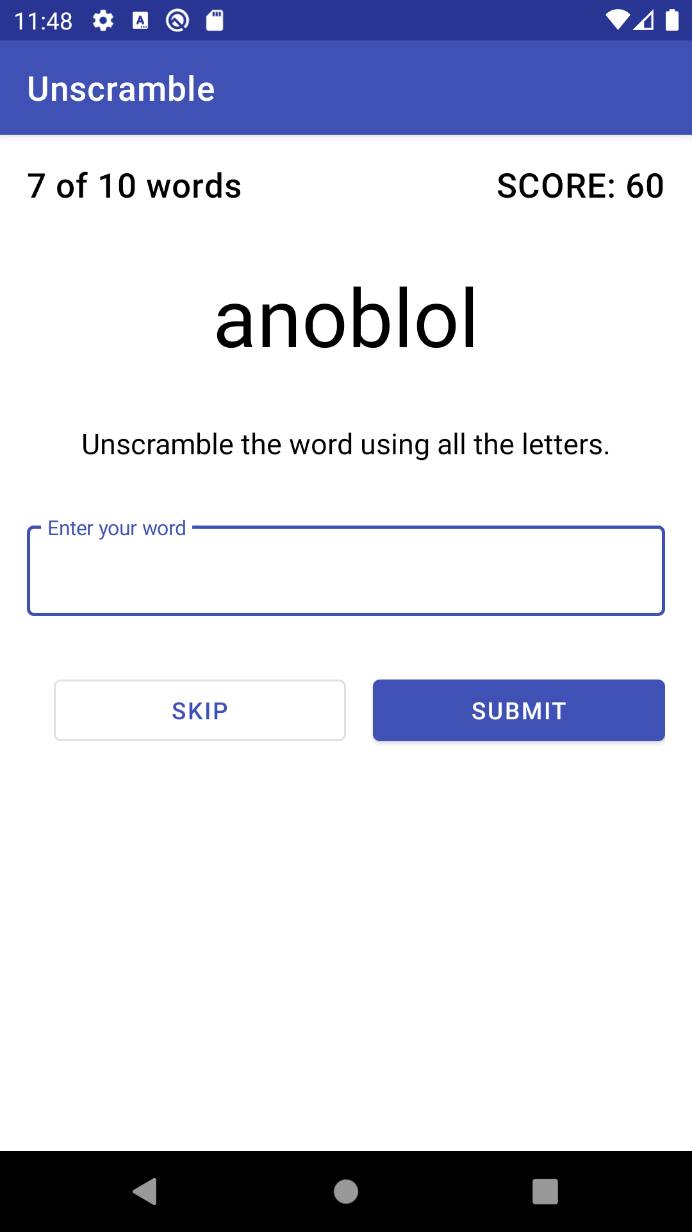
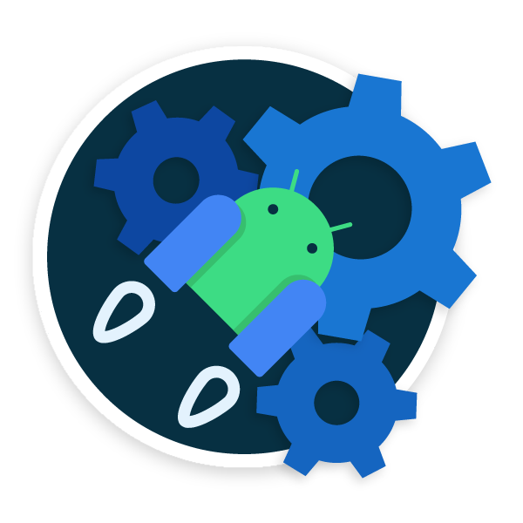
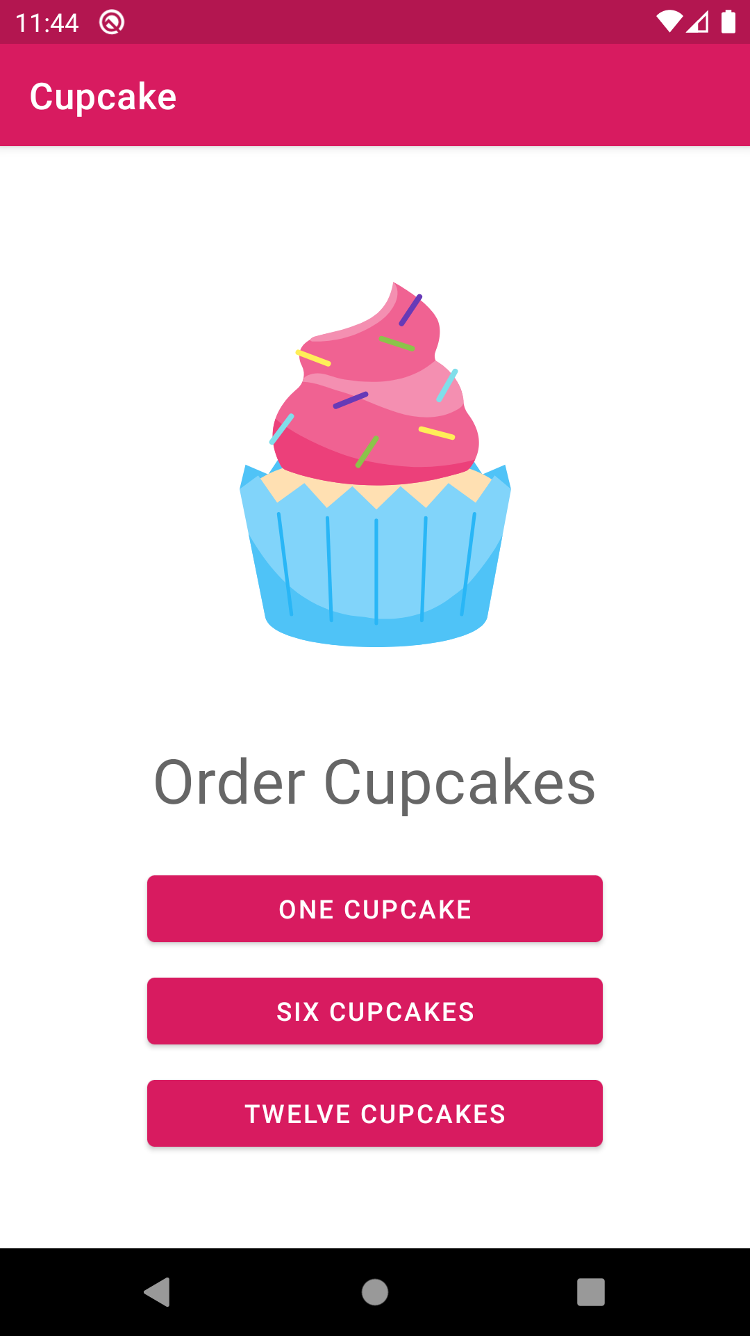

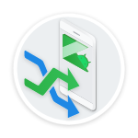
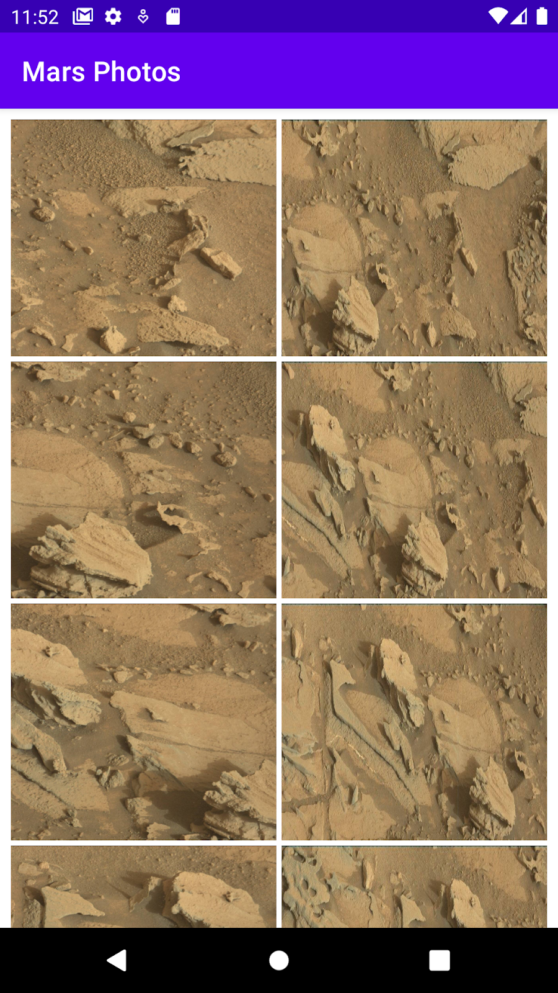
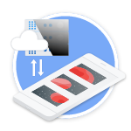
Overview of what you’ll learn
Badges
9
Architecture Components
Learn good app architecture principles by building a game app to unscramble words.
(2 hours)
10
Advanced
navigation examples
Combine what you’ve learned so far in a more advanced app that demonstrates navigating between multiple screens.
(2 hours)
11
Coroutines
Write code for more advanced and complex Android apps.
(1 hour)
12
Get and display data from the internet
Retrieve and display images over the internet with HTTP and REST.
(1 hour)

Slide 12
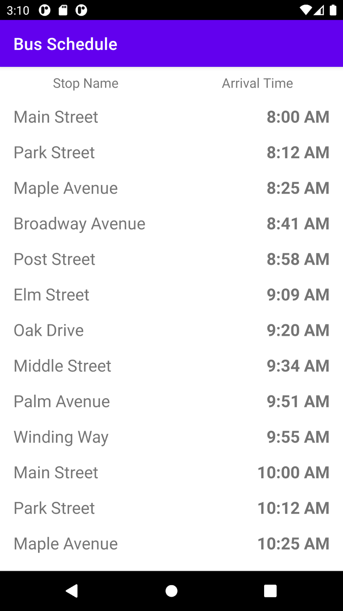
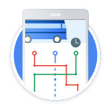
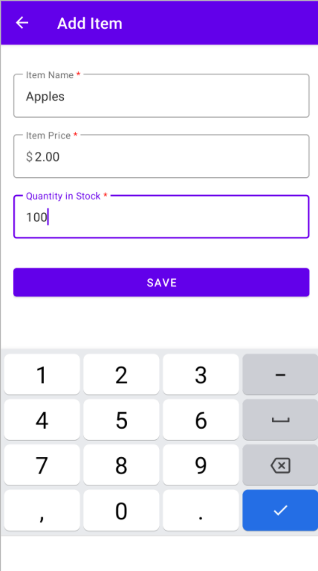

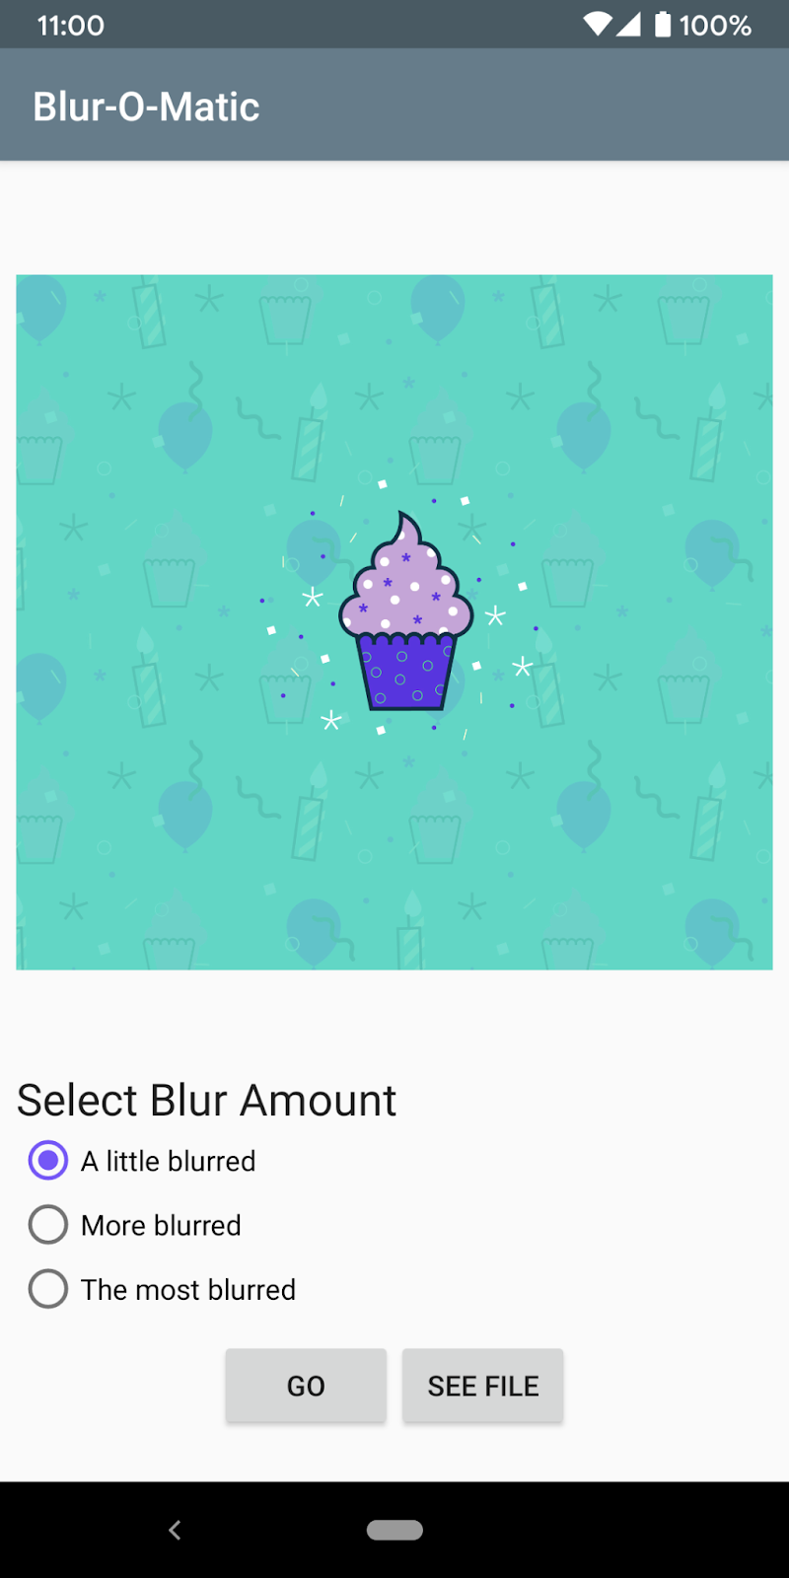
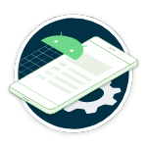
Overview of what you’ll learn
Badges
13
Introduction to SQL, Room, and Flow
Learn the basics of reading and manipulating data with SQL, and how to create and use relational databases in an Android app with the Room library.
(2 hours)
14
Use Room for data persistence
Use the Room library to allow your apps to read and write from a database.
(1 hour)
Schedule tasks with WorkManager
Learn when and how to use WorkManager, an API that handles background work that needs to run regardless of whether the application process is still running.
15
(1 hour)

Slide 13
Tentative Timetable
Official introductory session
Yay , completed the first milestone already!
Session 2
Pathway 5-6
Session 4
Pathway 11-14
Session 6
App building
sessions
30 Nov
15 Dec
26 Dec
29 Nov
3 Dec
20 Dec
27 Dec-5 Jan
Session 1
Pathway 1-4
Session 3
Pathway 7-10
Session 5
Pathway 15-16

Slide 14
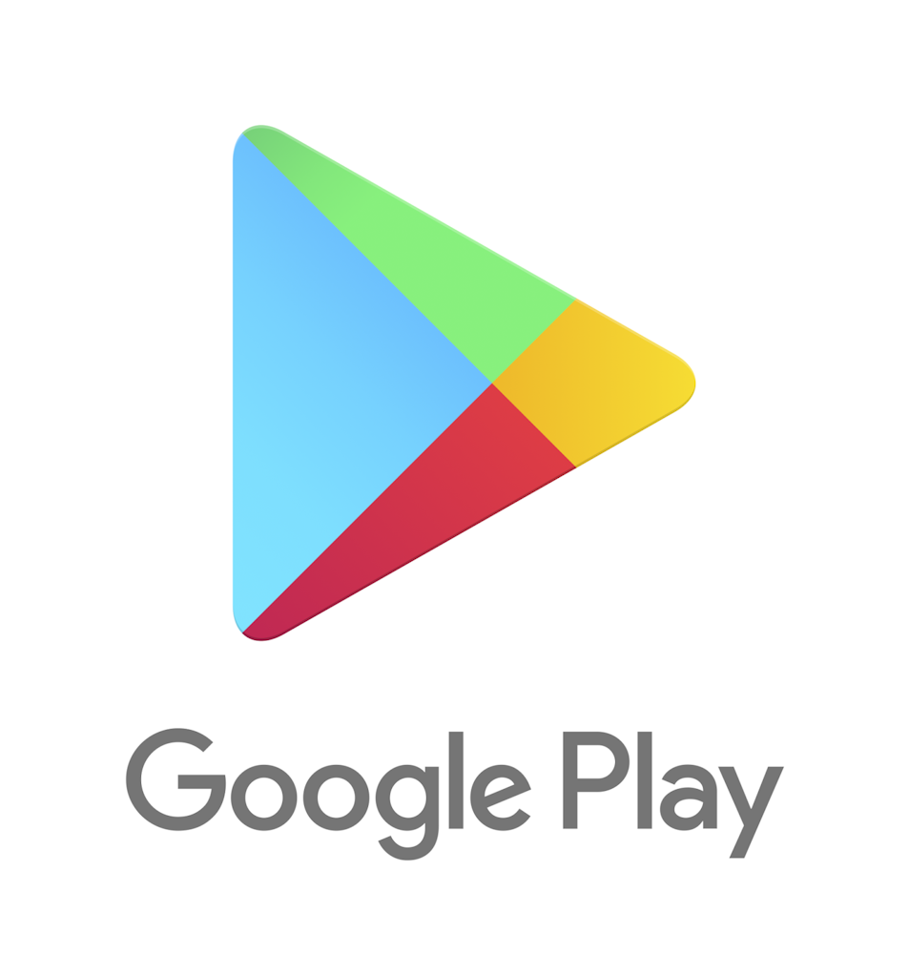
Why should you enroll in Android Study Jams?
Learn Android and Kotlin concepts by a teacher who learnt Android directly from Google Engineers
Earn cool badges every time you complete a pathway
Show off your certificate on social media profiles, résumé etc
Get a chance to build a real life working app that might get featured by Google

Slide 15

Why Kotlin as Dev Language
1. Kotlin is expressive, statically typed language for development on android and server. 2. It was 2010 by JetBrains which is free, open source and has 5.8 million developers around the world. 3. Google made Kotlin as first preference for developing apps. 4. Interopearbility with java 5. Provides Null Safety

Slide 16
Intresting facts about Kotlin
62 % of developers have expressed intrest in developing in kotlin (4th largest according to stack overflow survey)
20 % less time is spent on stabilisation after adopting kotlin due to less null pointer exception
30 % less code as compared to java
Time spent on reviews and maintainance is less
70 % of top 1000 apps on playstore are developed in Kotlin
60 % professional andriod developers use Kotlin

Slide 17
Have a Question? Just ask

